Slide 1


Introduction to AI Bots
<Cloud Computing Day - 8/>

Slide 2
MSFT AI CB
What is Msft AI Chatbot ?
Unlocking Conversational AI with Microsoft Power Platform

Slide 3
Microsoft Power Virtual Agents is a no-code chatbot development platform by Microsoft. It allows users to create AI-powered chatbots, integrate them with various services, and deploy them on multiple channels for customer support and automation, all without extensive coding. It emphasizes ease of use, scalability, and security.

Slide 4
Benefits

Slide 5
Easy to use: Azure Bot Service provides a variety of tools and services to make it easy to build, deploy, and manage bots.
Scalable: Azure Bot Service is a highly scalable service that can handle millions of concurrent users.
Reliable: Azure Bot Service is a reliable service that is backed by Microsoft's global infrastructure.
Secure: Azure Bot Service provides a variety of security features to protect your data and your customers' data.

Slide 6
Use Cases
E-commerce
Healthcare
Customer Support
As a sales/support assistant to clarify doubts on the product and other services.
As an assist bot for appointments, billing, and insurance in hospitals.
As a bot to assist customers on clarifying FAQs.

Slide 7
Challenge Time !

Slide 8
We are going to build a Generative AI Chatbot trained on data from VIT Chennai Website.
It’s not limited to any particular website, you can just unleash your creativity to create a Generative AI Chatbot on any website’s data.

Slide 9
We have unique Azure Bot Services for building AI Bots in Microsoft Azure. https://portal.azure.com/#home
However, You can also build Chatbots via Microsoft Power Virtual Agents.
https://web.powerva.microsoft.com/environments/
Let’s look into it in the Live Demo.

Slide 10
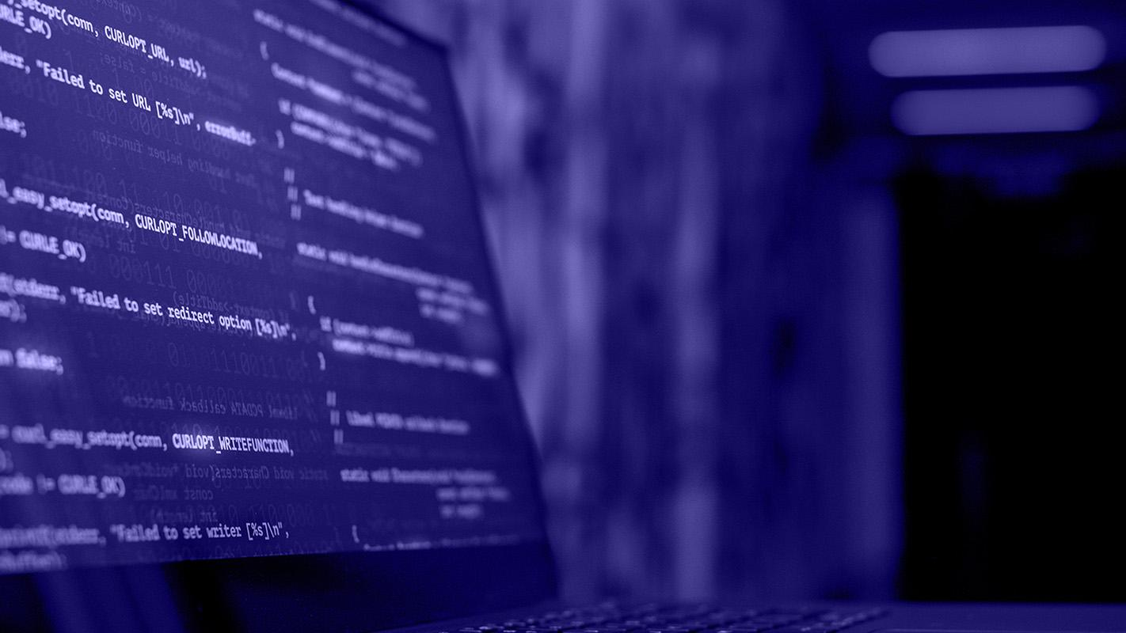
Let’s dive into hands on play with Microsoft AI Bot Services.

Slide 11
Best Practices

Slide 12
Before going into Azure it’s always necessary to follow some practices like
*DELETING ALL RESOURCES BEFORE EXITING THE LAB*
Its always necessary to delete all the resources else, it would end up for you to pay in USD $ for the everything.

Slide 13
Kindly delete all the bots created using Microsoft Power Virtual Agents after the lab to avoid paying bill after your free trial. ⚠️

Slide 14
THANKS for joining!

